Slide 1








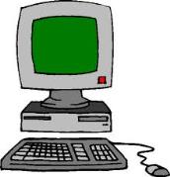
SmartButler ® Mini-Bar
Inefficient work practices.
Guests check out before charges are made to their bill.
SmartButler® Mini-Bar.
Charges to bill made quickly and efficiently.
Ensures that all mini-bar charges are made to guest bills.
315
215
115

